Slide 1
Hierarchical Clustering

Slide 2
Outline
What is Hierarchical Clustering?
Dendrogram
Types of Hierarchical Clustering

Slide 3
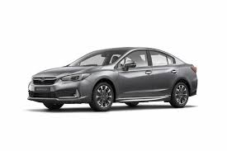

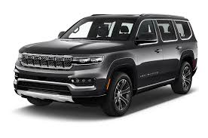
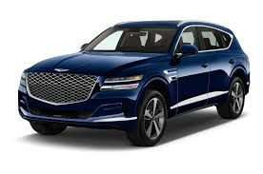
Let us consider that we have a set of cars and we have to group similar one’s together

Slide 4
We have two clusters of car types, Sedan and SUV

Slide 5
And then we group everything into one Car cluster

Slide 6
And then we group everything into one Car cluster
We terminate when we are left with only one cluster

Slide 7
Hierarchical clustering
Hierarchical Clustering is separating data into different groups based on some measure of similarity

Slide 8
Hierarchical clustering
Unlike k-means, hierarchical clustering doesn’t require the user to specify the number of clusters beforehand.
Instead, it returns an output (typically as a dendrogram)
The user will then decide the appropriate number of clusters (either manually or algorithmically).

Slide 9
Dendrogram
A tree-like diagram that shows the hierarchical relationship between objects or groups of objects.

Slide 10
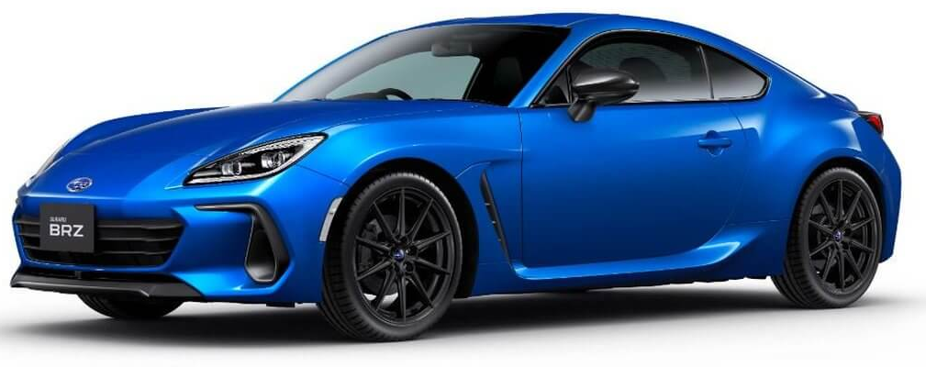
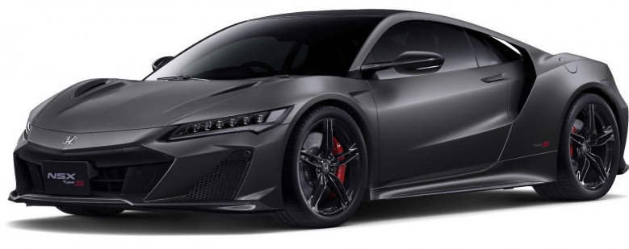
Data
Dendrogram

Slide 11
Data
Dendrogram
We now have 1 cluster, the Sedan cluster

Slide 12
Data
Dendrogram
We now have 2 clusters, the Sedan and Sports car cluster

Slide 13
Data
Dendrogram
We now have 3 clusters, the Sedan and Sports car and SUV cluster

Slide 14
Data
Dendrogram
The height of the dendrogram indicates the order in which the clusters were joined.
We now have 2 clusters, the rear wheel drive cluster and SUV cluster

Slide 15
Data
Dendrogram
We now have 1 cluster, the Car cluster

Slide 16
Data
Dendrogram
Dendrograms are often used to show the arrangement of clusters created by hierarchical clustering

Slide 17
Hierarchical clustering
If done manually, the user may cut the dendrogram where the merged clusters are too far apart (represented by a long lines in the dendrogram). Alternatively, the user can just return a specific number of clusters (similar to k-means).

Slide 18
Types of Hierarchical Clustering
Agglomerative Clustering is known as bottom-up approach.

Slide 19
Types of Hierarchical Clustering
Divisive Clustering is known as top-down approach.

Slide 20
How Hierarchical clustering works?
P5
P6
P4
P3
P2
P1
Let us consider we have plotted a few data points of our dataset on a two-dimensional plane

Slide 21
How Hierarchical clustering works?
P5
P6
P4
P3
P2
P1
The next step is to find the least distance between two data points to form a cluster

Slide 22
Dendrogram
P5
P6
P4
P3
P2
P1
P1
P2
P3
P4
P5
P6
The two

Slide 23
Dendrogram
P5
P6
P4
P3
P2
P1
P1
P2
P3
P4
P5
P6
The two nearest datapoints are merged together to form a cluster

Slide 24
Dendrogram
P5
P6
P4
P3
P2
P1
P1
P2
P3
P4
P5
P6
Dendrograms are often used to show the arrangement of clusters created by hierarchical clustering

Slide 25
Dendrogram
P5
P6
P4
P3
P2
P1
P1
P2
P3
P4
P5
P6
Dendrograms are often used to show the arrangement of clusters created by hierarchical clustering

Slide 26
Dendrogram
P5
P6
P4
P3
P2
P1
P1
P2
P3
P4
P5
P6
Dendrograms are often used to show the arrangement of clusters created by hierarchical clustering

Slide 27
Dendrogram
P5
P6
P4
P3
P2
P1
P1
P2
P3
P4
P5
P6
Dendrograms are often used to show the arrangement of clusters created by hierarchical clustering

